Slide 1
Electronics Manufacturing Intelligence Hub: Production, Sales, Profitability & Supply Chain Analytics

Slide 2
Objectives
Project Overview:
Introduction to this dataset, project goals, and business objectives.
Data Analysis & Visualization:
Exploratory Data Analysis (EDA), sales trends, products, profitability, customer behavior, and supply chain analysis using Excel.
Recommendations & Conclusion:
Strategies and recommendations to improve sales, customer engagement, and overall business performance.

Slide 3
Project Overview
Introduction:
The objective of this project to analyse Electronics manufacturing, sales and operational performance using data analytics techniques. This project helps identify sales trends, product performance, profitability, customer behaviour and supply chain operations to support data-driven business decisions.
Tools & Techniques Used
Excel
Power Query – Data Cleaning & Analysis
Power Pivot – Data Modeling
Pivot Tables & Pivot Charts – KPIs & Visualization
Dashboard – Reporting & Insights

Slide 4
Data Collection
I need to gather data from the client.
UNDERSTANDING THE DATA AND BUSINESS
1. Entire Dataset Description:
This dataset is used to analyze the complete electronics manufacturing business lifecycle, covering production operations, product performance, sales transactions, customer behavior, and supply chain logistics.
Niche of my data:
This dataset contains information about production, sales, shipment, products, customer, facility and dates full details for their electronics.

Slide 5
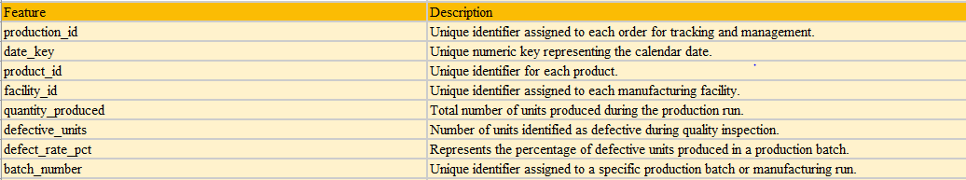
Data set description
1. Production Fact Table: Stores production-related transactions including quantities produced and defective units. This table contains Rows – 4500 and Columns – 8.

Slide 6
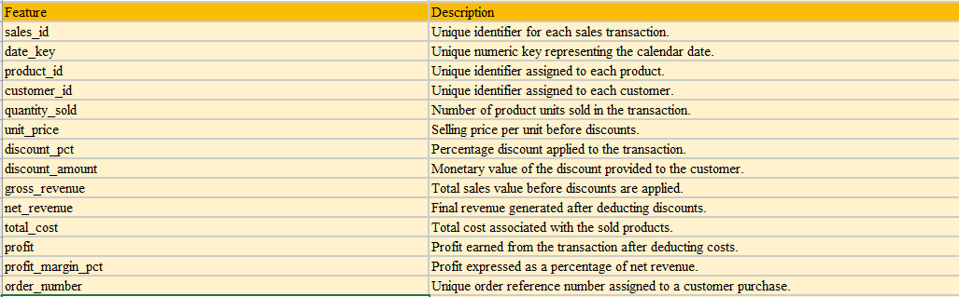
2. Sales fact table: Contains sales transaction data including revenue, profit, discounts, and quantity sold. This table contains Rows – 8500 and Columns – 14.

Slide 7
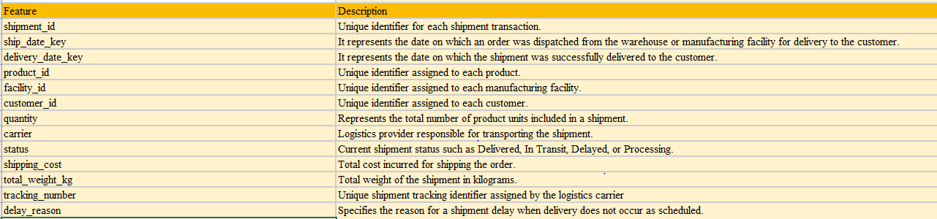
3. Shipment fact table: Stores shipment and logistics information including shipment cost, carrier, and delivery details. This table contains Rows – 7500, Columns – 13.

Slide 8
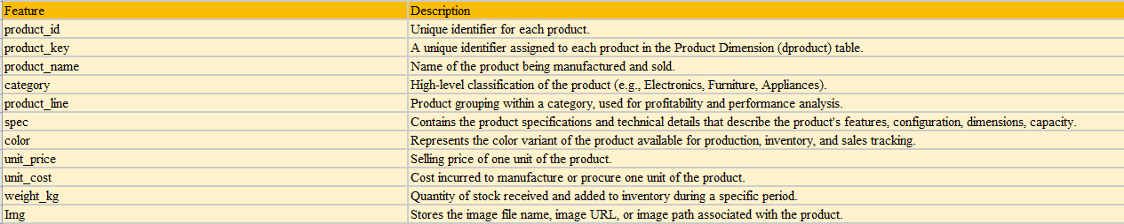
4. Product dimension table: Contains product details such as product name, category, brand, and product line. This table contains Rows – 16, Columns – 11.

Slide 9
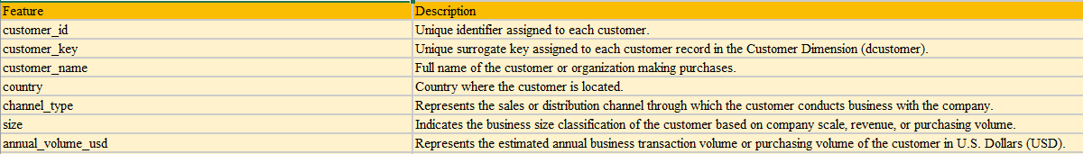
5. Customer dimension table: This table contains customer master data and demographic information. It is used to analyze customer purchasing behavior, revenue contribution, geographic distribution, and customer segmentation.. This table contains Rows – 5, Columns – 7.

Slide 10
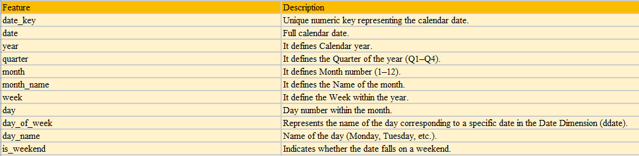
6. Date dimension table: Date dimension used for time-based analysis such as monthly, quarterly, and yearly trends. This table contains Rows – 731, Columns – 11.

Slide 11
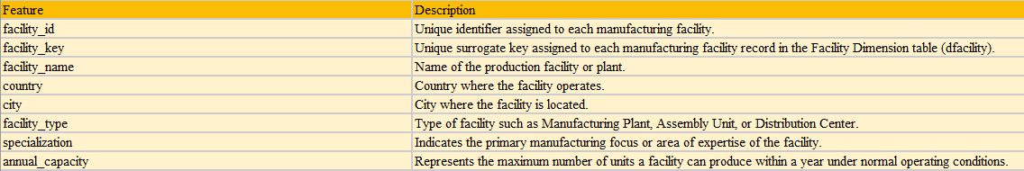
7. Facility dimension table: Contains manufacturing facility information including plant location and production capacity. This table contains Rows – 6, Columns – 8.

Slide 12
ETL Pipeline:
ETL Process Flow
Extract (E)
The project data was extracted from multiple CSV files from client given data.
2. Transform (T)
The transformation phase was performed using Power Query Editor to ensure high-quality and analysis-ready data.
a) Changed Data Types
Converted each column to the appropriate data type.
b) Handling Null Values
Identified and treated missing values.
c) Removing Duplicates
Duplicate records were identified using unique business keys and removed.
d) Data Standardization
Standardized data to maintain consistency across all tables.
3. Load (L)
After completing all transformations to load the file in excel.

Slide 13
Data modeling
Data Model Description:
This data model follows a star schema architecture with multiple fact and dimension tables that enable comprehensive business intelligence and KPI reporting.
Relationship | Cardinality | Description
ddate → fsales | One-to-Many (1:*) | Connects each sales transaction to its corresponding order date, enabling Year, Quarter, Month, and Daily sales analysis.
ddate → fproduction | One-to-Many (1:*) | Links production records to the production date for analyzing manufacturing trends over time.
ddate → fshipment (Ship Date) | One-to-Many (1:*) | Associates shipment records with the shipment date to monitor shipping activities and logistics performance.
ddate → fshipment (Delivery Date) | One-to-Many (1:*) | Links shipment records to the delivery date for evaluating delivery timelines and delays.
dcustomer → fsales | One-to-Many (1:*) | Connects customers with their sales transactions, enabling customer revenue, profitability, and purchasing behavior analysis.
dcustomer → fshipment | One-to-Many (1:*) | Associates customers with shipment records for tracking delivery status and customer fulfillment performance.
dproduct → fsales | One-to-Many (1:*) | Links products to sales transactions, supporting product-wise revenue, profit, and sales trend analysis.
dproduct → fproduction | One-to-Many (1:*) | Connects products to production records, enabling production quantity and defect analysis by product.
dproduct → fshipment | One-to-Many (1:*) | Associates products with shipment records to analyze shipping volumes and logistics by product.
dfacility → fproduction | One-to-Many (1:*) | Connects manufacturing facilities with production records to evaluate production capacity, output, and quality performance.
dfacility → fshipment | One-to-Many (1:*) | Links facilities with shipment records to analyze shipment volumes, delivery efficiency, and logistics performance by plant.

Slide 14
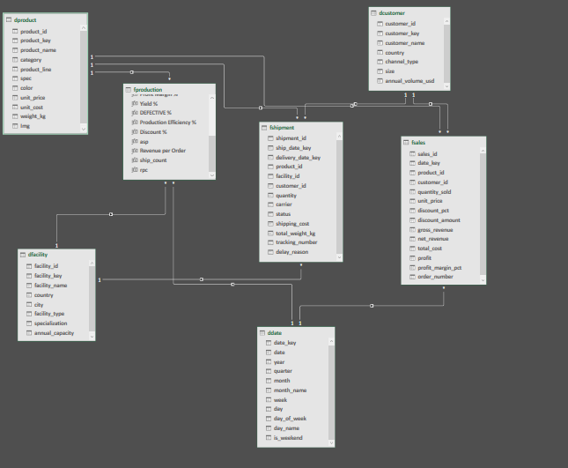

Slide 15
1.SalEs Performance analysis 1. Is revenue growing consistently?
Observation:
Revenue remains relatively stable during the first nine months, fluctuating between ₹12 million and ₹15 million, indicating consistent baseline business performance.
A significant surge occurs in Month 10, where revenue reaches its highest level of approximately ₹21 million, followed by a slight decline in Month 11 and a recovery in Month 12.
Understanding the drivers behind the Month 10 spike can help replicate this success in future periods.

Slide 16
2.Are profits growing along with revenue?
Observation:
October recorded the highest revenue (₹21.27M) and also the highest profit (₹6.22M), showing a strong positive relationship between revenue and profitability.
December and November also delivered strong revenue and profit performance, making the final quarter the most profitable period of the year.
Throughout the year, profit remains relatively proportional to revenue, indicating stable margin management.

Slide 17
3. Which product categories drive business?
Observation:
Smartphones account for more than half of total revenue (56%), making them the dominant contributor to business growth.
Television products contribute approximately 15% of revenue, making them the second-largest revenue-generating category.
Tablets generate around 11% of total revenue, providing a moderate contribution to overall sales.

Slide 18
4.Which products generate the highest revenue?
Observation:
Galaxy S24 Ultra is the highest revenue-generating product, contributing approximately ₹34.49 million, followed by Galaxy Z Fold5 with ₹27.68 million.
These products significantly outperform the remaining products in the portfolio, indicating strong customer demand and premium market positioning.

Slide 19
Sales analysis insights
1. Seasonal Sales Pattern
Insight:
Sales increase significantly during the final quarter, suggesting strong seasonal demand driven by holidays and promotional events.
2. Revenue Concentration
Insight:
A limited number of products account for a substantial portion of total revenue.
3. Pricing Strategy
Insight:
Premium products achieve both high revenue and strong profitability, indicating customer willingness to pay for premium offerings.
Recommendation:
Continue focusing on high-margin products while monitoring operational costs to sustain profit growth.
Continue investing in the smartphone segment while developing strategies to increase sales of lower-performing categories through product bundling and targeted promotions.
Maintain adequate inventory of top-selling products and expand complementary accessories to increase average order value.
Optimize discount strategies based on profitability rather than increasing discounts across all products.

Slide 20
2.Production Analysis 1. Which plants contribute most production?
Observation:
Production is distributed across three manufacturing facilities, with Thai Nguyen Plant contributing the highest production output at approximately 1.30 million units.
Gumi Appliance Plant closely follows with around 1.29 million units, while Gumi Manufacturing 1 records approximately 1.24 million units, making it the lowest producer among the three.

Slide 21
2. Which factory has quality issues?
Observation:
The Thai Nguyen Plant has the highest defect rate at approximately 0.00632 (0.632%), indicating it experiences slightly more quality issues than the other manufacturing facilities.
Gumi Manufacturing 1 and Gumi Appliance Plant report defect rates of 0.00628 (0.628%) and 0.00627 (0.627%), respectively.
The variation in defect rates across facilities is very small, demonstrating that overall manufacturing quality is consistent.

Slide 22
3. Are production volumes stable?
Observation:
Production remains consistent during Months 1–9, with only minor month-to-month fluctuations.
Month 10 records the highest production output (approximately 410,675 units), indicating a major increase in manufacturing activity.
Production remains above earlier monthly averages in Months 11 and 12, showing sustained operational performance after the peak.
The positive trendline suggests gradual improvement in production output over the course of the year.

Slide 23
4. Which product lines are causing defects?
Observation:
The Galaxy S product line records the highest number of defects across all manufacturing facilities, making it the primary contributor to overall production defects.
In contrast, home appliance product lines such as Refrigerator and Washer report the fewest defects, indicating stronger quality performance.

Slide 24
production analysis insights
1. Manufacturing Efficiency
Insight:
High production output combined with relatively low defect rates indicates efficient manufacturing operations.
Production processes appear well-balanced across facilities.
2. Production Planning
Insight:
Manufacturing output aligns well with seasonal sales demand, reducing inventory shortages during peak business periods.
3. Defect Cost Reduction
Insight:
Even small defect rates can generate significant financial losses when production volumes are high.
Recommendation:
Continue capacity planning based on demand forecasts to maximize equipment utilization and avoid production bottlenecks.
Analyze best practices from high-performing plants and implement them across other facilities to improve overall productivity.
Maintain demand-driven production planning to optimize inventory levels while avoiding overproduction.

Slide 25
3.Profitability Analysis 1. Which product category generate the highest revenue?
Observation:
The Smartphone category is the highest revenue-generating product category, contributing approximately ₹98.71 million, which is significantly higher than all other categories.
This highlights smartphones as the primary driver of business revenue and customer demand.
The large revenue gap between Smartphones and the remaining categories indicates that the business is highly dependent on its smartphone product portfolio.

Slide 26
2. Identify the Most Profitable Product Lines
Observation:
The Galaxy S product line is the most profitable, generating approximately ₹14.84 million in profit, followed by Galaxy Z with ₹11.09 million.
Together, these two smartphone product lines contribute a substantial share of total profitability, highlighting them as the company's strongest profit drivers.

Slide 27
3. Which product lines are causing defects?
Observation:
The analysis indicates that higher discounts do not necessarily lead to higher profitability.
Although the Smartphone category generates the highest revenue and profit despite offering discounts, other categories with similar or even higher discount percentages contribute significantly lower profits.
This suggests that profitability is influenced by a combination of pricing strategy, product demand, and cost structure rather than discounts alone.

Slide 28
4. Are costs increasing faster than revenue?
Observation:
Revenue remains higher than total cost in every month, resulting in positive profit throughout the year and Both revenue and costs show a gradual upward trend, but revenue increases at a faster rate, especially during the final quarter.
Month 10 records the highest revenue (₹21.27 million), highest cost (₹15.06 million), and highest profit (₹6.22 million), demonstrating efficient cost management during peak sales.
Despite higher operating costs in Months 10–12, profit continues to increase, indicating that additional revenue more than offsets the increase in costs.

Slide 29
profitability analysis insights
1. Discount Effectiveness
Insight:
Higher discounts do not always result in higher profits.
Some product categories achieve better profit margins with moderate discount levels.
2. Margin Optimization
Insight:
Product profitability varies significantly across the portfolio, highlighting opportunities for margin improvement.
3. Seasonal Profit Trends
Insight:
Profit peaks during the final quarter, reflecting increased customer demand and successful seasonal sales campaigns.
Recommendation:
Continue focusing on high-margin products while maintaining effective cost control strategies to maximize profitability.
Allocate additional marketing and inventory resources during high-performing months to maximize profit opportunities.
Continue monitoring procurement and operational expenses to preserve healthy profit margins as the business scales.
Increase investment in high-performing product lines while reviewing pricing, production costs, and marketing strategies for low-profit products.

Slide 30
4.Customer & Supply Chain Analysis 1. Which customer generate the most revenue?
Observation:
Amazon.com Inc. is the highest revenue-generating customer, contributing approximately ₹36.75 million, followed closely by Flipkart with ₹36.49 million and Best Buy Co. Inc. with ₹36.08 million.
The top four customers contribute comparable revenue, indicating a well-balanced customer portfolio with no excessive dependence on a single customer.

Slide 31
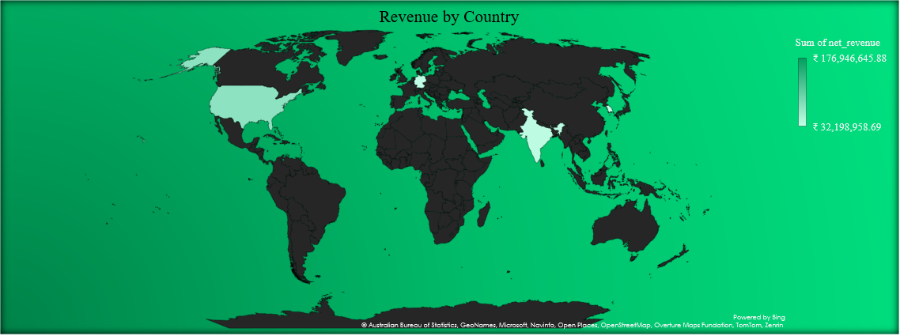
2. Which regions generate the most revenue?
Observation:
The United States is the highest revenue-generating region, contributing approximately ₹176.95 million, making it the company's largest market.
Other regions, including India and Germany, also generate substantial revenue but at comparatively lower levels.

Slide 32
3. Online vs Direct vs Retail contribution.
Observation:
The Online and Retailer channels are the primary contributors to the business, each accounting for 41% of total customer contribution.
In comparison, the Direct sales channel contributes 18%, indicating that the business relies more heavily on indirect sales channels for revenue generation.

Slide 33
4. Which carrier is most expensive?
Observation:
UPS Worldwide incurs the highest shipping cost at approximately ₹2.42 million, making it the most expensive logistics carrier.
It is followed by XPO Logistics (₹2.30 million) and Kuehne+Nagel (₹2.19 million). In contrast, DHL Express has the lowest shipping cost at approximately ₹1.88 million, indicating a more cost-effective shipping option.

Slide 34
5. What is the Distribution of Shipment Delivery Statuses?
Observation:
The majority of shipments have been successfully delivered, with 5,647 deliveries, indicating a highly efficient and reliable logistics operation.
A smaller number of shipments remain In Transit (1,140), while Delayed (573) and Processing (140) shipments represent only a small portion of the overall shipment volume.

Slide 35
Customer & Supply Chain analysis insights
1. Delivery Performance
Insight:
Most shipments are successfully delivered, indicating a reliable logistics network.
Delayed shipments account for only a small proportion but still affect customer satisfaction.
2. Customer Satisfaction & Fulfillment
Insight:
A high delivery completion rate reflects efficient order fulfillment and strong supply chain performance.
Faster deliveries improve customer retention and brand reputation.
3. Revenue per Customer
Insight:
Average revenue per customer highlights the value of each customer relationship.
High-value customers contribute significantly to total revenue.
Recommendation:
Develop loyalty programs and customized pricing agreements for top customers.
Increase investments in high-performing markets while expanding sales in emerging regions to diversify revenue.
Strengthen direct-to-customer sales through digital marketing, loyalty programs, and exclusive online offerings.
Regularly evaluate carrier performance by balancing cost, delivery speed, and service quality to optimize logistics expenses.

Slide 36
Conclusion:
This project successfully analysed Electronics business performance using Microsoft Excel. Through data cleaning, analysis, and interactive dashboards, valuable insights were generated across Sales, Product, Profitability, Customer and Supply chain operations. The findings provide actionable recommendations to support better business decisions and improve overall performance.

Slide 37
Thank You

